Slide 1
PSYC003: Psychological Influences on Health & Behaviour
Stress & Coping
School of Psychology, University of Plymouth
Dr Rob Heirene
March 2023

Slide 2

About me
Name: Dr Rob Heirene
Office: A210 Portland Square
Email: Rob.Heirene@Plymouth.ac.uk

Slide 3


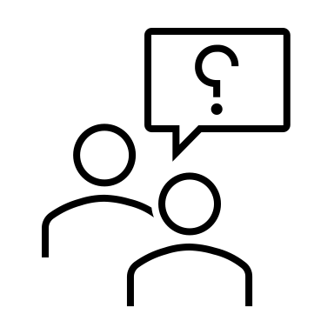

About today’s class
Block 1
Stress & illness
Stress as a stimulus
Stress as an interaction between event & individual
Stress as a physiological response
Stress & health
Interactive task: How do we cope with stress?
~10-minute break
Block 2
Coping & illness moderators
What is coping?
Personality
Interactive task: How do we compare to research findings (optimism)?
Locus of control
Social support
Cross-cultural differences
~5-minute break

Slide 4
Block 1 Stress & Illness

Slide 5


Stress & illness
Typically studied & conceptualized in three ways:
As a stimulus or event external to the individual
As an interaction between a stimulus event & the cognitive & emotional characteristics of the individual
As a physiological reaction

Slide 6
Stress & illness Stress as a stimulus
Stress can be considered as the response to an event or events
Life events theory (Holmes & Rahe, 1967):
Various life events disrupt our lives in some way (i.e., they are stressful)
Social readjustment: The intensity & length of time necessary to accommodate a life event, regardless of the desirability of the event
Life events have a cumulative effect on stress levels
Key tenets of this approach
Events can be objectively labelled & measured (e.g., retiring)
Components can be measured (e.g., proximity to event)
Can include seemingly negative (e.g., divorce) and positive (e.g., marriage) events.
Often involves studying catastrophic events (e.g., 9/11, natural disasters) & major life events (e.g., new job, holidays)

Slide 7
Representative life event items from the Social Readjustment Rating Scale (Holmes & Rahe, 1967)
Event | LCU rating (1-100)
Death of a spouse | 100
Divorce | 75
Death of a close family member | 63
Personal injury or illness | 53
Marriage | 50
Being fired from work | 47
Retirement | 45
Major change in the health or behaviour of a family member | 44
Pregnancy | 40
Sex difficulties | 39
Death of a close friend | 37
Change to a different job | 36
Foreclosure of mortgage or loan | 30
Son or daughter leaving home | 29
In-law troubles | 29
Outstanding personal achievement | 28
Begin or end formal schooling | 26
Troubles with the boss | 23
Change in social activities (clubs, movies, visting etc.) | 18
Vacations | 13
Christmas | 12
Stress & illness Stress as a stimulus
Social Readjustment Rating Scale (Holmes & Rahe, 1967)
Do these events resonate with your sense of stressful life events?
How applicable are they today?

Slide 8
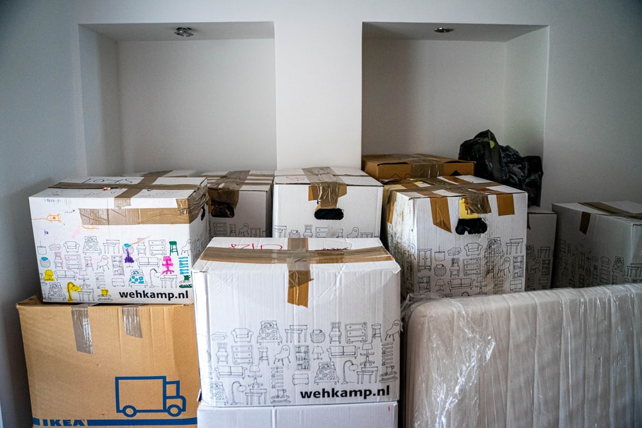

Stress & illness Stress as a stimulus
Limitations of life events measurement:
Many studies supporting links between LCUs & health rely on retrospective reporting
Cultural/regional appropriateness & frequency issues
Entanglement
Life “hassles”?
Ambiguities in items
Assumes consistent interpretation (Dohrenwend et al., 1990)
Assumes consistent responses

Slide 9

Stress & illness Stress as an interaction between event & individual
“The mind is its own place and, in itself can make a heaven of hell, a hell of heaven”
John Milton, Paradise Lost
Appraisal is central to whether an event is deemed to be a stressor (Lazarus, 1964)
Cognitive Transactional Model of Stress (Lazarus & Folkman, 1987):
When people confront a new or challenging environment they engage in a process of appraisal
Appraisal comes in two forms
Stress experienced when perceived harm or threat is high and perceived coping ability is low
Appraisals can vary over time
Primary vs. secondary appraisal
Primary appraisal: Evaluation of the stimulus event (harm, threaten, challenge)
E.g., “Is it relevant to me?, “If potentially negative, then does it pose me harm/threat/challenge?”
Secondary appraisal: Evaluation of one’s ability to cope with the stressor
E.g., “How am I going to deal with this?”, “Who can I call on to help me with this?”

Slide 10
Stress & illness Stress as an interaction between event & individual
Developments in the Transactional Model of Stress to include motivational elements:
Primary appraisal made of:
Motivational relevance
Motivational congruence
Secondary appraisal made of:
Internal/external accountability
Problem-focused coping potential
Emotion-focused coping potential
Future expectancy concerning situational change
“Benign” event
“Stressful” event
Event not perceived as harmful or threatening & high perceived coping
Event perceived as harmful or threatening & high perceived coping
Event not perceived as harmful or threatening & low perceived coping
Event perceived as harmful or threatening & low perceived coping

Slide 11
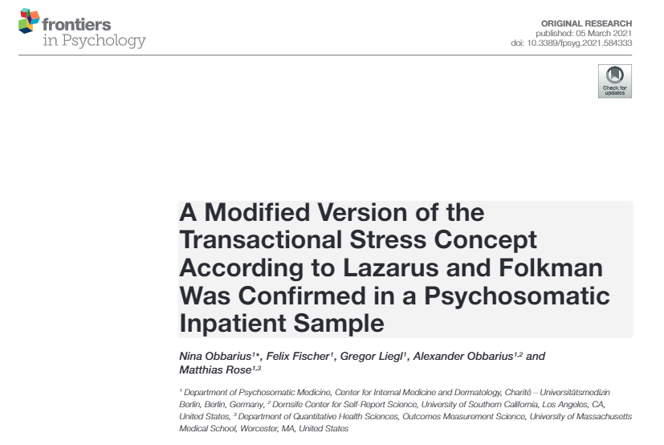
Stress & illness Stress as an interaction between event & individual
Strengths of the Transactional Model of Stress:
Acknowledges individual differences in response
Considers cognitive & emotional components
Highly supported & studied
Limitations of the Transactional Model of Stress:
Risk of circularity
Some events are more inherently “stressful” than others
High stress events
Those that are:
Imminent
Unpredictable
Ambiguous
Undesirable
Outside of one’s control
Life changing

Slide 12
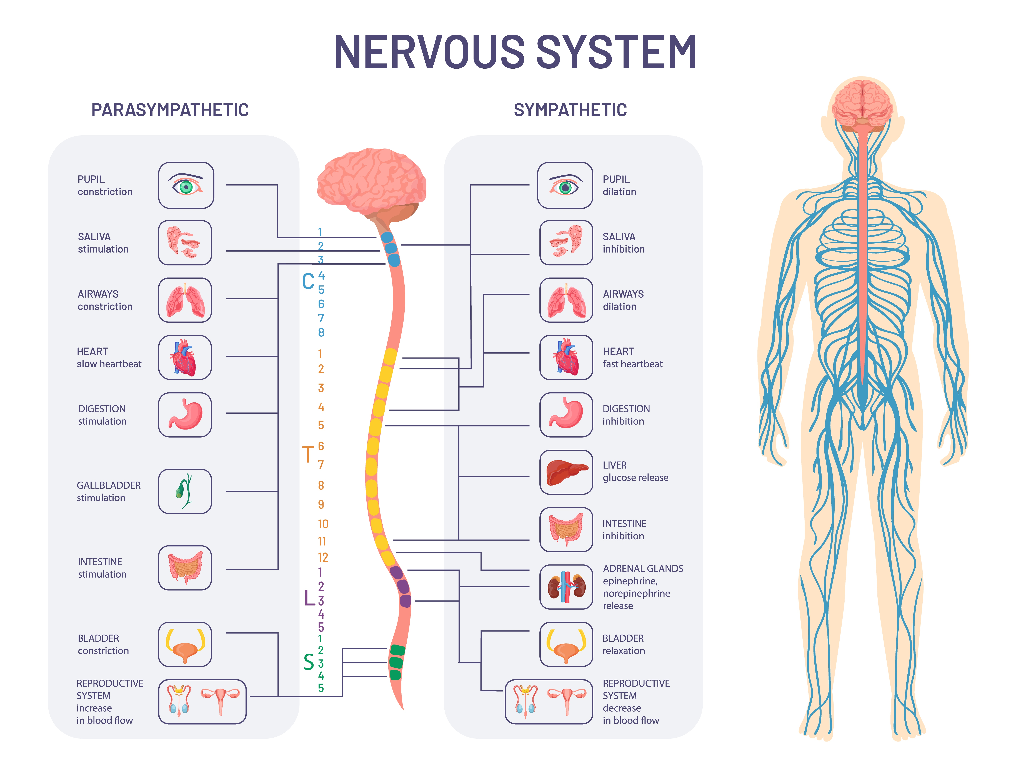
Stress & illness Stress as a physiological response
Nervous system
Central nervous system
Peripheral nervous system
Somatic nervous system
Autonomic nervous system
Parasympathetic division
Sympathetic division

Slide 13
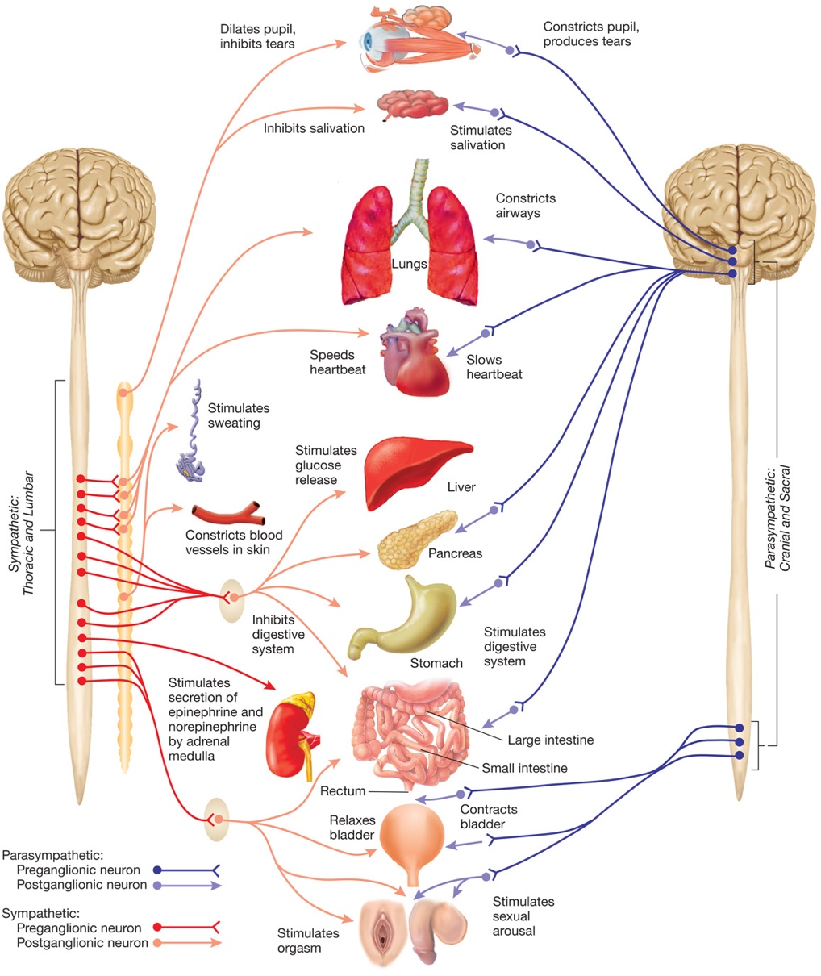
Stress & illness Stress as a physiological response
Sympathetic Adrenal-Medullary (SAM) System
Stressful event
Hypothalamus & sympathetic nervous system stimulate the adrenal medulla
Release catecholamine stress hormones

Slide 14
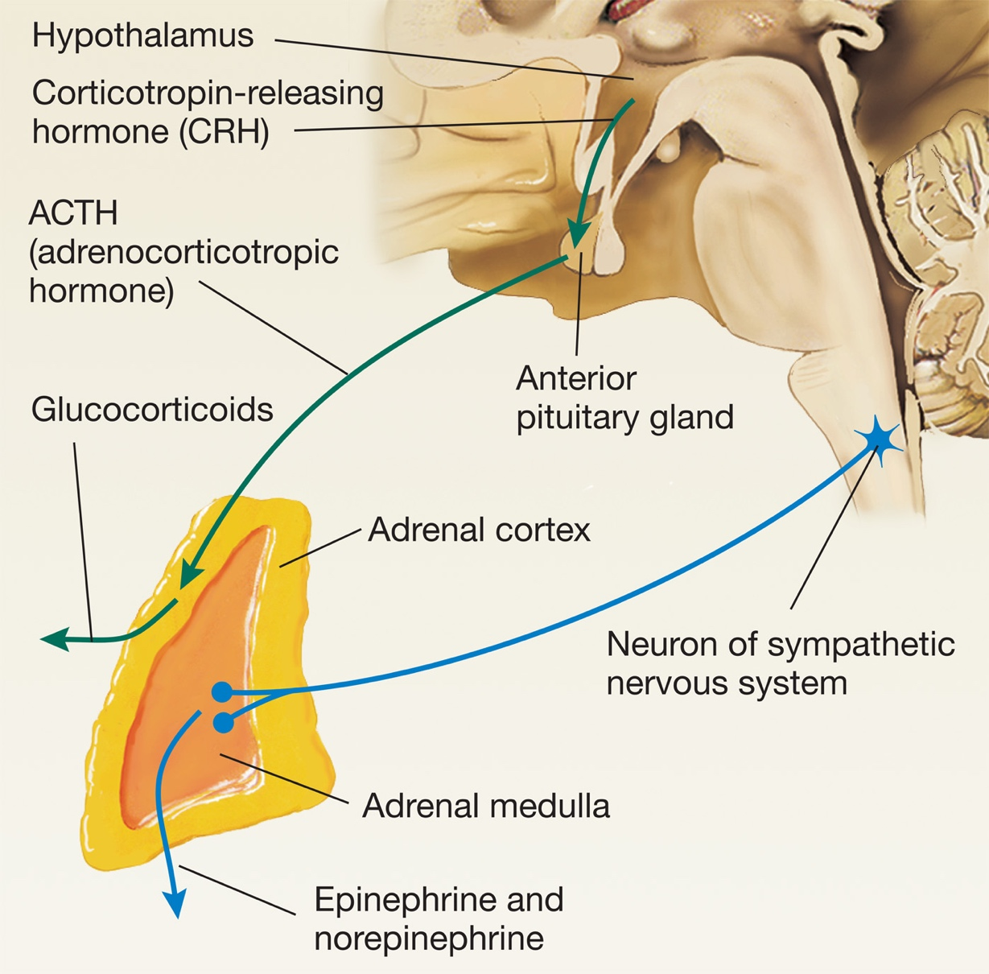

Stress & its effect on our body Stress response
Hypothalamic-Pituitary Adrenocortical (HPA) System
Stressful event
Hypothalamus secretes corticotropin releasing hormone
Regulation of mood in response to stress
Stimulates the anterior pituitary gland to which secretes adrenocorticotropic hormone
Stimulates the adrenal cortex to secrete glucocorticoids

Slide 15
Stress & illness Stress & health
 | Stress response system
 | Sympathetic Adrenal-Medullary (SAM) System | Hypothalamic-Pituitary Adrenocortical (HPA) System
Hormones | Catecholamines (adrenaline & noradrenaline) | Glucocorticoids (cortisol)
Intended duration | Fast-acting, short-lived | More sustained response
The duration of the physiological responses to stress influences whether they are beneficial or not

Slide 16
Stress & its effect on our body Stress & health
Wound healing:
Slower wound recovery (Gouin & Kiecolt-Glaser (2011)
Surgery complications:
Increased complications post-operation (Mavros et al., 2011)
The common cold:
Increased risk (Cohen et al. 1991; Takkouche et al., 2001
COVID-19:
Poorer outcomes (Ramezani, et al. 2020)
Stress & immune function
Glucocorticoids & (to a lesser extent) catecholamines suppress the immune response
High stress levels are associated with (Segerstrom & Miller, 2004):
Decreased lymphocyte proliferation
Decreases in natural killer (NK) cells
Decreased pro-inflammatory cytokines
Lower antibody response to vaccines (Burns et al., 2003)

Slide 17
Stress & illness Stress & health
Behavioural response to stress
Personality type
Use of services
Elevated stress
Direct physiological changes
Poor health outcomes

Slide 18
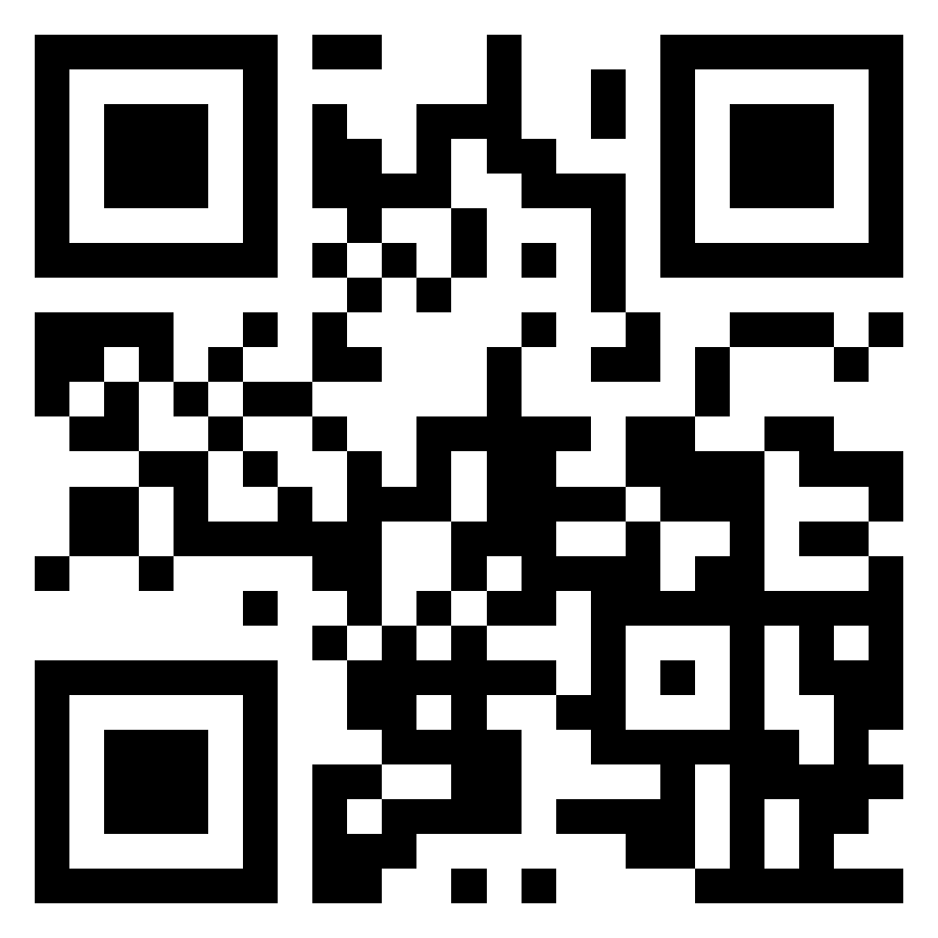
Stress & illness Interactive Task
Please go to the following site & enter this number:
TBC
How do you cope with stress?
Log on to Menti and add your thoughts and strategies
Let’s compare our experiences with what psychological research & theory says about coping styles!
https://www.menti.com/

Slide 19
Block 2 Coping & illness moderators

Slide 20
Coping & illness moderators What is coping?
What is it?
Anything a person does to reduce the impact of the perceived or actual stressor
A volitional effort to alter a stressor or how it’s interpreted
Adaptive coping:
Adaptive coping increases our functioning and decreases the perceived level of stress
Maladaptive coping temporarily decreases the perceived level of stress but may ultimately make it worse. May also de
Problem-focused coping
Attention/approach, monitoring, vigilant, active
Coping efforts directed at the stressor in order to reduce the demands of it or increase one’s resources
Efforts concerned with attending to the source of the stress and trying to deal with the problem
Emotion-focused coping
Avoidant, blunting, passive
Coping efforts directed at managing the emotional response to the stressor
Efforts concerned with avoiding or minimizing the threat of the stressor

Slide 21





Coping & illness moderators Personality
Big-5 and stress
Neuroticism
high levels of neuroticism are typically associated with high levels of perceived distress, cortisol levels & depression (Banjongrewadee et al., 2020; Hudek-Knežević & Kardum, 2009; O’Súilleabháin et al., 2020)
Conscientiousness
Associated with reduced cortisol levels and increased longevity (Bogg & Roberts, 2004; Hill et al., 2011; Steptoe et al., 2017)
Neuroticism
Emotional stability
Neurotic
Extroversion
Introversion
Extraversion
Openness
Closed
Open
Agreeableness
Hostile
Agreeable
Conscientiousness
Spontaneous
Conscientious

Slide 22

Coping & illness moderators Personality
Personality types and stress
Type A
Type B
Type C
Type D

Slide 23
Coping & illness moderators Personality
Brief Stress Questionnaire
1. In the last month, how often have you felt that you were unable to control the important things in your life?
2. In the last month, how often have you felt confident about your ability to handle your personal problems?
3. In the last month, how often have you felt that things were going your way?
4. In the last month, how often have you felt difficulties were piling up so high that you could not overcome them?
Item | Score
The next question deals with optimism. Optimists are people who look to the future with confidence and who mostly expect good things to happen. How would you describe yourself? How optimistic are you in general? | Where would you place yourself on a scale from 1 (not at all optimistic) to 7 (very optimistic)?
2. The next question is about pessimism. Pessimists are people who are full of doubt when they look to the future and who mostly expect bad things to happen. How would you describe yourself? How pessimistic are you in general? | Where would you place yourself on a scale from 1 (very pessimistic) to 7 (not at all pessimistic)?
0 = Never
1 = Almost Never
2 = Sometimes
3 = Fairly Often
4 = Very Often
Reverse score items 2 & 3: (e.g., 0 = 4, 1 = 3, 2 = 2, 3 = 1 & 4 = 0)

Slide 24
Stress & illness Interactive Task
Please go to the following site & enter this number:
TBC
Is optimism associated with stress among us?
Jot down your scores
Log on to Menti and add your scores in response to the questions
Let’s compare our outcomes with what psychological research…
https://www.menti.com/

Slide 25

Coping & illness moderators Personality
Optimism
Dispositional optimism: having a generally stable positive outlook on life and positive outcome expectations
Associated with a reduction in the incidence of coronary heart disease, all-cause mortality, stroke, re-hospitalization following heart surgery, and the negative life impact of cancer (Avvenuti et al., 2016).
Associated with better social & mental functioning among those with chronic illnesses (Colby & Shifren, 2013)
Reduced smoking rates, more walking and physical exercise, and moderate alcohol consumption (Steptoe et al., 2006)

Slide 26
Coping & illness moderators Locus of control
A trait-like expectation that one’s actions will be effective in controlling or mastering the environment
Health locus of control (HLoC): the belief that health is in one’s control
High internal LoC has been associated with:
Self-reported health among people at risk for cardiovascular disease (Berglund et al., 2014)
Improved treatment outcomes (Zuercher-Huerlimann et al., 2019)
Self-reported health, fewer physical or mental health conditions, decreased use of healthcare (Kesavayuth et al., 2020)
Locus of control
Internal
External

Slide 27
Coping & illness moderators Social support
Types & functions of social support | Types & functions of social support
 | “Provider” offers | “Recipient” receives/benefit
Emotional support | Empathy, care, or concern | Reassurance, sense of comfort and belonging that
Esteem support | Positive regard, encouragement, positive comparisons | Builds self-worth, sense of confidence, feeling valued
Tangible/ practical support | Direct assistance | Reduces strain
Informational support | Advice, suggestions, feedback | Self-worth, self-efficacy
Network support | Welcoming Shared experiences | Sense of belonging Affiliation
Actual or perceived support from others
Social support can come from a variety of sources:
Friends, partners, family, colleagues, health and social care professionals, support groups
Yamagata Study
Feeling like you have someone available to take you to the hospital associated with reduction in all-cause mortality (Uzuki et al., 2020)

Slide 28
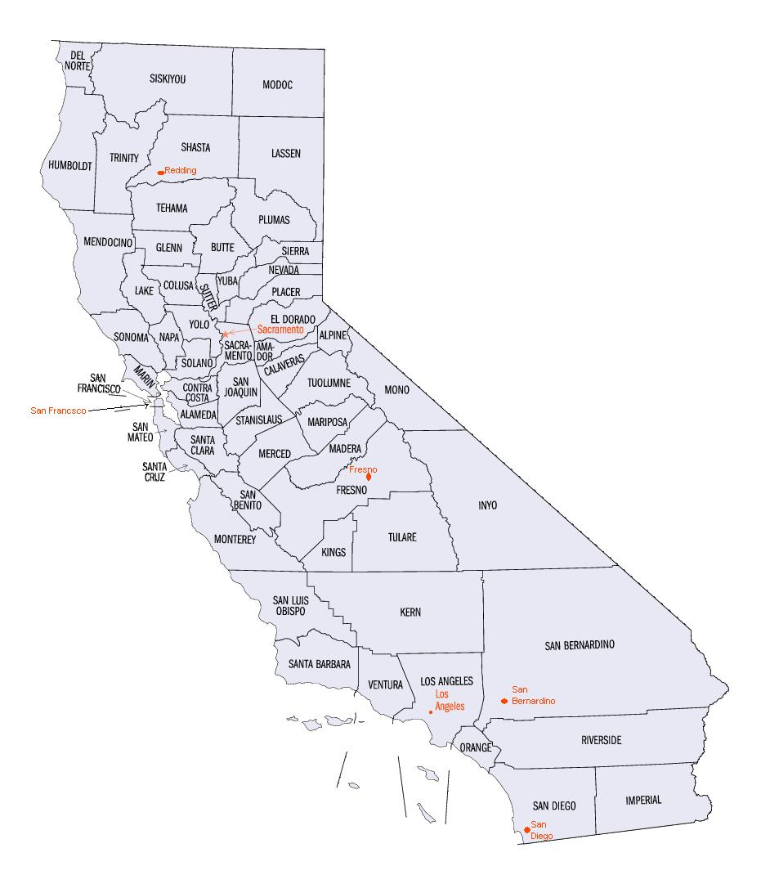
Coping & illness moderators Social support
Relationship between social support and stress:
Greater social support is consistently associated with lower stress levels (Qi et al., 2020; Woodhead et al., 2014)
Massive meta-analysis of social support & health (Vila, 2021):
1,187 studies with 1.46 million participants show a strong link between social support and reduced disease and mortality
How does social support affect health?
Direct effect hypothesis: Social support directly benefits our house irrespective of stress levels
Buffering hypothesis: Social support protects against the negative physiological effects of stress
The “Alameda County Study” (Berkman & Syme, 1979)
More than twofold increase in the risk of mortality for those with the fewest social ties
Image source: Wiki Commons

Slide 29


Coping & illness moderators
Cross-cultural differences
Stress and distress in Indigenous Australians
In 2006 the number of Aboriginal & Torres Strait Islander adults with a high distress score was 3 times more than non-indigenous adults (McNamara, 2018)
In 2012-13, 30% of Aboriginal & Torres Strait Islander adults were assessed as having high levels of psychological distress (2.7. times more than non-indigenous adults; AIHW, 2015)
Worldwide differences in stress?
Click here!

Slide 30
Coping & illness moderators Interactive task
Please go to the following site & enter this number:
TBC
Do collectivist and individualist societies differ in the level of stress?
Why?
Scan the literature on this topic
Login to Menti and add your findings and suggestions
Class discussion
https://www.menti.com/

Slide 31

Summary: Factors affecting stress
(Some of) the things we know that moderate the effects of stress:
Coping style
Personality
Social support
Locus of control
Culture

Slide 32
Next week: Diet & weight management

Slide 33
Credits & Sources
Where possible, I have included a link to the source for all images used in this slideshow. If an image in this slideshow does not have a link to the source posted below it, then I have either:
Taken it from the site www.unsplash.com and clicking the image will take you to the original source on unsplash.
OR
Used images directly from the Carlson & Brickett (2017) textbook resources provided by the publisher

Slide 34
References
Australian Institute of Health and Welfare (AIHW) (2015). The health and welfare of Australia’s Aboriginal and Torres Strait Islander peoples: 2015. https://www.aihw.gov.au/reports/indigenous-health-welfare/indigenous-health-welfare-2015/contents/determinants-of-health-key-points
Avvenuti, G., Baiardini, I. & Giardini, A. (2016). Optimism’s Explicative Role for Chronic Diseases. Frontiers in Psychology, 7, 295. https://doi.org/10.3389/fpsyg.2016.00295
Banjongrewadee, M., Wongpakaran, N., Wongpakaran, T., Pipanmekaporn, T., Punjasawadwong, Y. & Mueankwan, S. (2020). The role of perceived stress and cognitive function on the relationship between neuroticism and depression among the elderly: a structural equation model approach. BMC Psychiatry, 20(1), 25. https://doi.org/10.1186/s12888-020-2440-9
Berglund, E., Lytsy, P. & Westerling, R. (2014). The influence of locus of control on self-rated health in context of chronic disease: a structural equation modeling approach in a cross sectional study. BMC Public Health, 14(1), 492–492. https://doi.org/10.1186/1471-2458-14-492

Slide 35
References
Berkman, l. f. & Syme, S. L. (1979). SOCIAL NETWORKS, HOST RESISTANCE, AND MORTALITY: A NINE-YEAR FOLLOW-UP STUDY OF ALAMEDA COUNTY RESIDENTS. American Journal of Epidemiology, 109(2), 186–204. https://doi.org/10.1093/oxfordjournals.aje.a112674
Bogg, T. & Roberts, B. W. (2004). Conscientiousness and Health-Related Behaviors: A Meta-Analysis of the Leading Behavioral Contributors to Mortality. Psychological Bulletin, 130(6), 887–919. https://doi.org/10.1037/0033-2909.130.6.887
Burns, V. E., Carroll, D., Drayson, M., Whitham, M., & Ring, C. (2003). Life events, perceived stress and antibody response to influenza vaccination in young, healthy adults. Journal of Psychosomatic Research, 55(6), 569–572. https://doi.org/10.1016/S0022-3999(03)00073-4
Cohen, S., Tyrrell, D. A. J. & Smith, A. P. (1991). Psychological Stress and Susceptibility to the Common Cold. The New England Journal of Medicine, 325(9), 606–612. https://doi.org/10.1056/nejm199108293250903
Colby, D. A. & Shifren, K. (2013). Optimism, mental health, and quality of life: A study among breast cancer patients. Psychology, Health & Medicine, 18(1), 10–20. https://doi.org/10.1080/13548506.2012.686619
Dohrenwend, B. P., Link, B. G., Kern, R., Shrout, P. E., & Markowitz, J. (1990). Measuring life events: The problem of variability within event categories. Stress Medicine, 6(3), 179–187. https://doi.org/10.1002/smi.2460060303

Slide 36
References
Gouin, J.-P. & Kiecolt-Glaser, J. K. (2011). The Impact of Psychological Stress on Wound Healing: Methods and Mechanisms. Immunology and Allergy Clinics of North America, 31(1), 81–93. https://doi.org/10.1016/j.iac.2010.09.010
Hill, P. L., Turiano, N. A., Hurd, M. D., Mroczek, D. K. & Roberts, B. W. (2011). Conscientiousness and Longevity: An Examination of Possible Mediators. Health Psychology, 30(5), 536–541. https://doi.org/10.1037/a0023859
Holmes, T. H. & Rahe, R. H. (1967). The social readjustment rating scale. Journal of Psychosomatic Research, 11(2), 213–218. https://doi.org/10.1016/0022-3999(67)90010-4
Hudek-Knežević, J. & Kardum, I. (2009). Five-factor Personality Dimensions and 3 Health-related Personality Constructs as Predictors of Health. Croatian Medical Journal, 50(4), 394–402. https://doi.org/10.3325/cmj.2009.50.394
Kesavayuth, D., Poyago-Theotoky, J., Tran, D. B. & Zikos, V. (2020). Locus of control, health and healthcare utilization. Economic Modelling, 86, 227–238. https://doi.org/10.1016/j.econmod.2019.06.014

Slide 37
References
Lazarus, R. S. & Folkman, S. (1987). Transactional theory and research on emotions and coping. European Journal of Personality, 1(3), 141–169. https://doi.org/10.1002/per.2410010304
Mavros, M. N., Athanasiou, S., Gkegkes, I. D., Polyzos, K. A., Peppas, G. & Falagas, M. E. (2011). Do Psychological Variables Affect Early Surgical Recovery? PLoS ONE, 6(5), e20306. https://doi.org/10.1371/journal.pone.0020306
McNamara, B. J., Banks, E., Gubhaju, L., Joshy, G., Williamson, A., Raphael, B. & Eades, S. (2018). Factors relating to high psychological distress in Indigenous Australians and their contribution to Indigenous–non-Indigenous disparities. Australian and New Zealand Journal of Public Health, 42(2), 145–152. https://doi.org/10.1111/1753-6405.12766
Nießen, D., Groskurth, K., Kemper, C. J., Rammstedt, B. & Lechner, C. M. (2022). The Optimism–Pessimism Short Scale–2 (SOP2): a comprehensive validation of the English-language adaptation. Measurement Instruments for the Social Sciences, 4(1), 1. https://doi.org/10.1186/s42409-021-00027-6
Obbarius, N., Fischer, F., Liegl, G., Obbarius, A. & Rose, M. (2021). A Modified Version of the Transactional Stress Concept According to Lazarus and Folkman Was Confirmed in a Psychosomatic Inpatient Sample. Frontiers in Psychology, 12, 584333. https://doi.org/10.3389/fpsyg.2021.584333

Slide 38
References
O’Súilleabháin, P. S. & Hughes, B. M. (2018). Neuroticism predicts all-cause mortality over 19-years: The moderating effects on functional status, and the angiotensin-converting enzyme. Journal of Psychosomatic Research, 110, 32–37. https://doi.org/10.1016/j.jpsychores.2018.04.013
Qi, M., Zhou, S.-J., Guo, Z.-C., Zhang, L.-G., Min, H.-J., Li, X.-M. & Chen, J.-X. (2020). The Effect of Social Support on Mental Health in Chinese Adolescents During the Outbreak of COVID-19. Journal of Adolescent Health, 67(4), 514–518. https://doi.org/10.1016/j.jadohealth.2020.07.001
Ramezani, M., Simani, L., Karimialavijeh, E., Rezaei, O., Hajiesmaeili, M. & Pakdaman, H. (2020). The Role of Anxiety and Cortisol in Outcomes of Patients With Covid-19. Basic and Clinical Neuroscience, 11(2), 179–184. https://doi.org/10.32598/bcn.11.covid19.1168.2
Segerstrom, S. C. & Miller, G. E. (2004). Psychological Stress and the Human Immune System: A Meta-Analytic Study of 30 Years of Inquiry. Psychological Bulletin, 130(4), 601–630. https://doi.org/10.1037/0033-2909.130.4.601
Steptoe, A., Easterlin, E. & Kirschbaum, C. (2017). Conscientiousness, hair cortisol concentration, and health behaviour in older men and women. Psychoneuroendocrinology, 86, 122–127. https://doi.org/10.1016/j.psyneuen.2017.09.016

Slide 39
References
Steptoe, A., Wright, C., Kunz-Ebrecht, S. R. & Iliffe, S. (2006). Dispositional optimism and health behaviour in community-dwelling older people: Associations with healthy ageing. British Journal of Health Psychology, 11(1), 71–84. https://doi.org/10.1348/135910705x42850
Takkouche, B., Regueira, C. & Gestal-Otero, J. J. (2001). A Cohort Study of Stress and the Common Cold. Epidemiology, 12(3), 345–349. https://doi.org/10.1097/00001648-200105000-00015
Uzuki, T., Konta, T., Saito, R., Sho, R., Osaki, T., Souri, M., Watanabe, M., Ishizawa, K., Yamashita, H., Ueno, Y. & Kayama, T. (2020). Relationship between social support status and mortality in a community-based population: a prospective observational study (Yamagata study). BMC Public Health, 20(1), 1630. https://doi.org/10.1186/s12889-020-09752-9
Vila, J. (2021). Social Support and Longevity: Meta-Analysis-Based Evidence and Psychobiological Mechanisms. Frontiers in Psychology, 12, 717164. https://doi.org/10.3389/fpsyg.2021.717164
Woodhead, E. L., Northrop, L. & Edelstein, B. (2014). Stress, Social Support, and Burnout Among Long-Term Care Nursing Staff. Journal of Applied Gerontology, 35(1), 84–105. https://doi.org/10.1177/0733464814542465

Slide 40
References
Zuercher-Huerlimann, E., Stewart, J. A., Egloff, N., Känel, R. von, Studer, M. & Holtforth, M. grosse. (2019). Internal health locus of control as a predictor of pain reduction in multidisciplinary inpatient treatment for chronic pain: a retrospective study. Journal of Pain Research, 12, 2095–2099. https://doi.org/10.2147/jpr.s189442

